Slide 1
Chapter 3:
Network Protocols and Communications
Network Basics
Notes:
Cisco Networking Academy program
Network Basics
Chapter 3: Network Protocols and Communications

Slide 2
Chapter 3: Objectives
Students will be able to:
Explain the role protocols and standards organizations in facilitating interoperability in network communications.
Explain how standards are established using the Request for Comments (RFC) process.
Explain how devices on a LAN access resources in a small to medium-sized business network.
Notes:
2

Slide 3
Chapter 3
  3.1 Network Protocols and Standards
  3.2 Using Requests for Comments
  3.3 Moving Data in the Network
  3.4 Summary
Notes:
Chapter 3 Sections

Slide 4
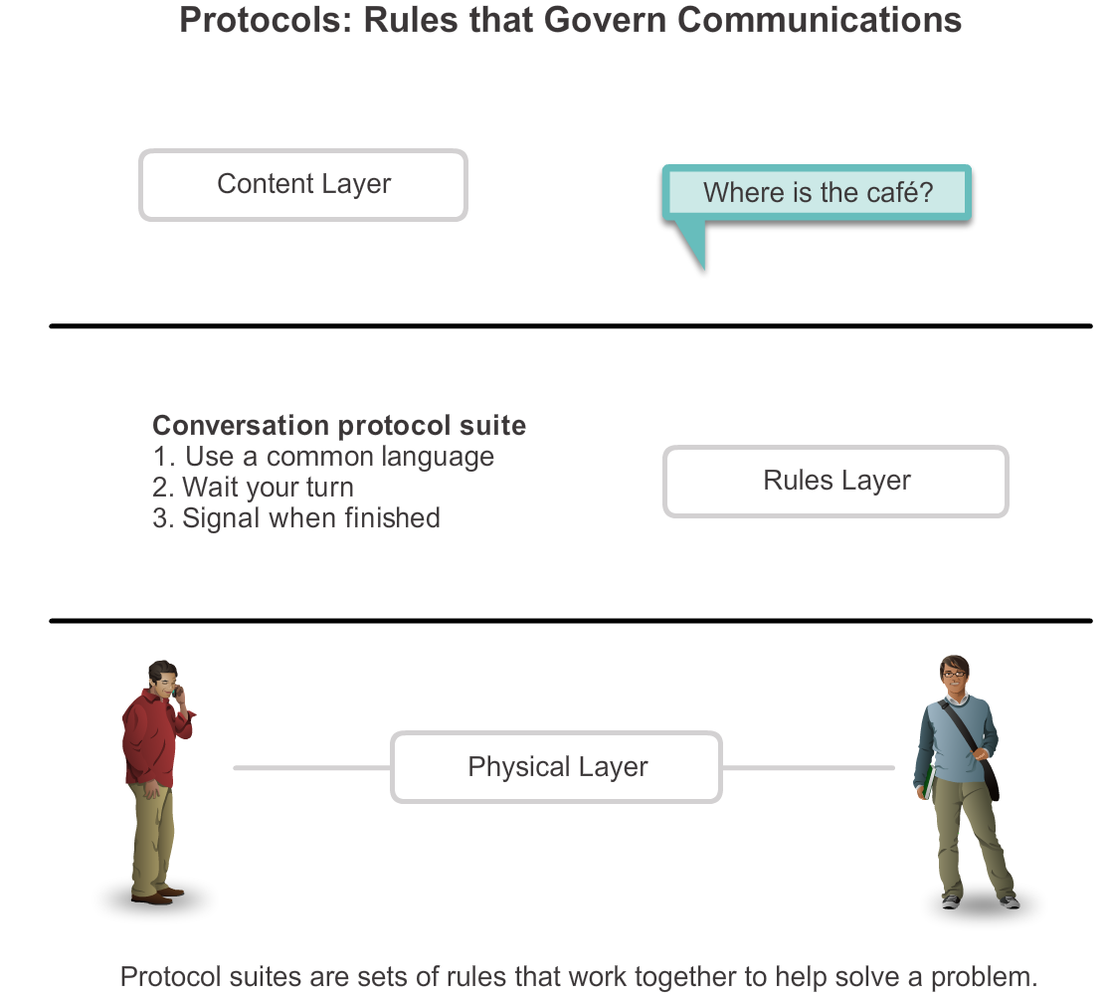
Protocols
Rules that Govern Communications
Notes:
Section 3.1.1.1

Slide 5
Protocols
Network Protocols
How the message is formatted or structured
The process by which networking devices share information about pathways with other networks
How and when error and system messages are passed between devices
The setup and termination of data transfer sessions
Notes:
Section 3.1.1.2

Slide 6
Protocols
Interaction of Protocols
Application Protocol – Hypertext Transfer Protocol (HTTP)
Transport Protocol – Transmission Control Protocol (TCP)
Internet Protocol – Internet Protocol (IP)
Network Access Protocols – Data Link & Physical layers
Notes:
Section 3.1.1.3

Slide 7
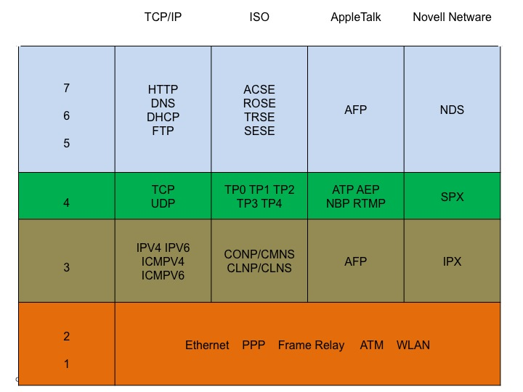
Protocol Suites
Protocol Suites and Industry Standards
Notes:
Section 3.1.2.1

Slide 8
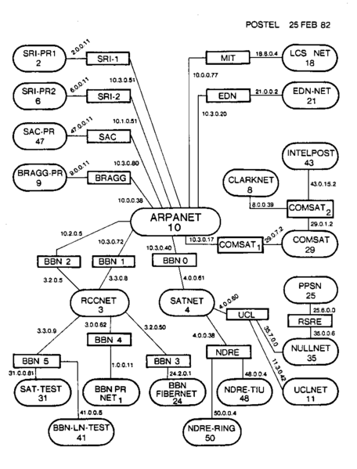
Protocol Suites
Creation of Internet, Development of TCP/IP
Notes:
Section 3.1.2.2

Slide 9
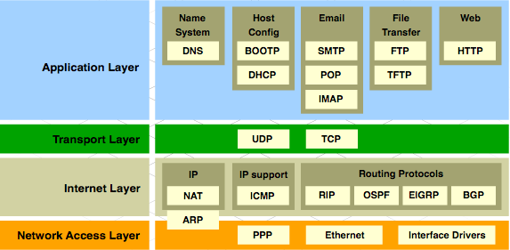
Protocol Suites
TCP/IP Protocol Suite and Communication
Notes:
Section 3.1.2.3

Slide 10







Network Protocols and Standards
Standards Organizations
Notes:
Section 3.1.3

Slide 11
Standards Organizations
Open Standards
The Internet Society (ISOC)
The Internet Architecture Board (IAB)
The Internet Engineering Task Force (IETF)
Institute of Electrical and Electronics Engineers (IEEE)
The International Organization for Standards (ISO)
Notes:
Section 3.1.3.1

Slide 12

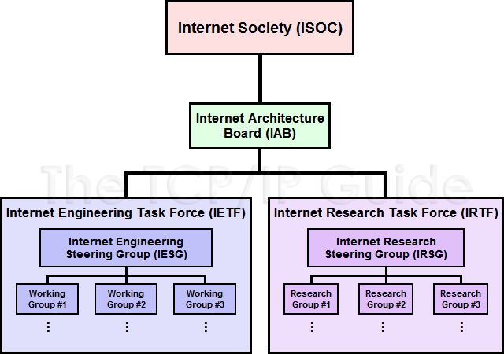


Standards Organizations
ISOC, IAB, and IETF
Notes:
Section 3.1.3.2

Slide 13
Standards Organizations
IEEE
38 societies
130 journals
1,300 conferences each year
1,300 standards and projects
400,000 members
160 countries
IEEE 802.3
IEEE 802.11
Notes:
Section 3.1.3.3

Slide 14
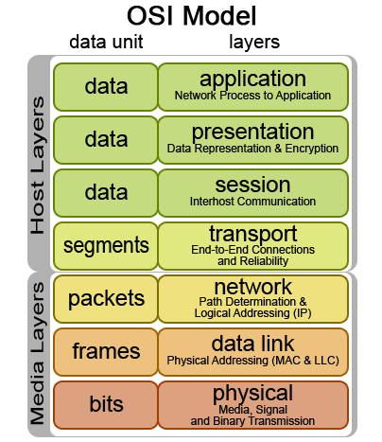

Standards Organizations
ISO
Notes:
Section 3.1.3.4

Slide 15
Standards Organizations
Other Standards Organization
The Electronic Industries Alliance (EIA)
The Telecommunications Industry Association (TIA)
The International Telecommunications Union – Telecommunications Standardization Sector (ITU-T)
The Internet Corporation for Assigned Names and Numbers (ICANN)
The Internet Assigned Numbers Authority (IANA)
Notes:
Section 3.1.3.5

Slide 16
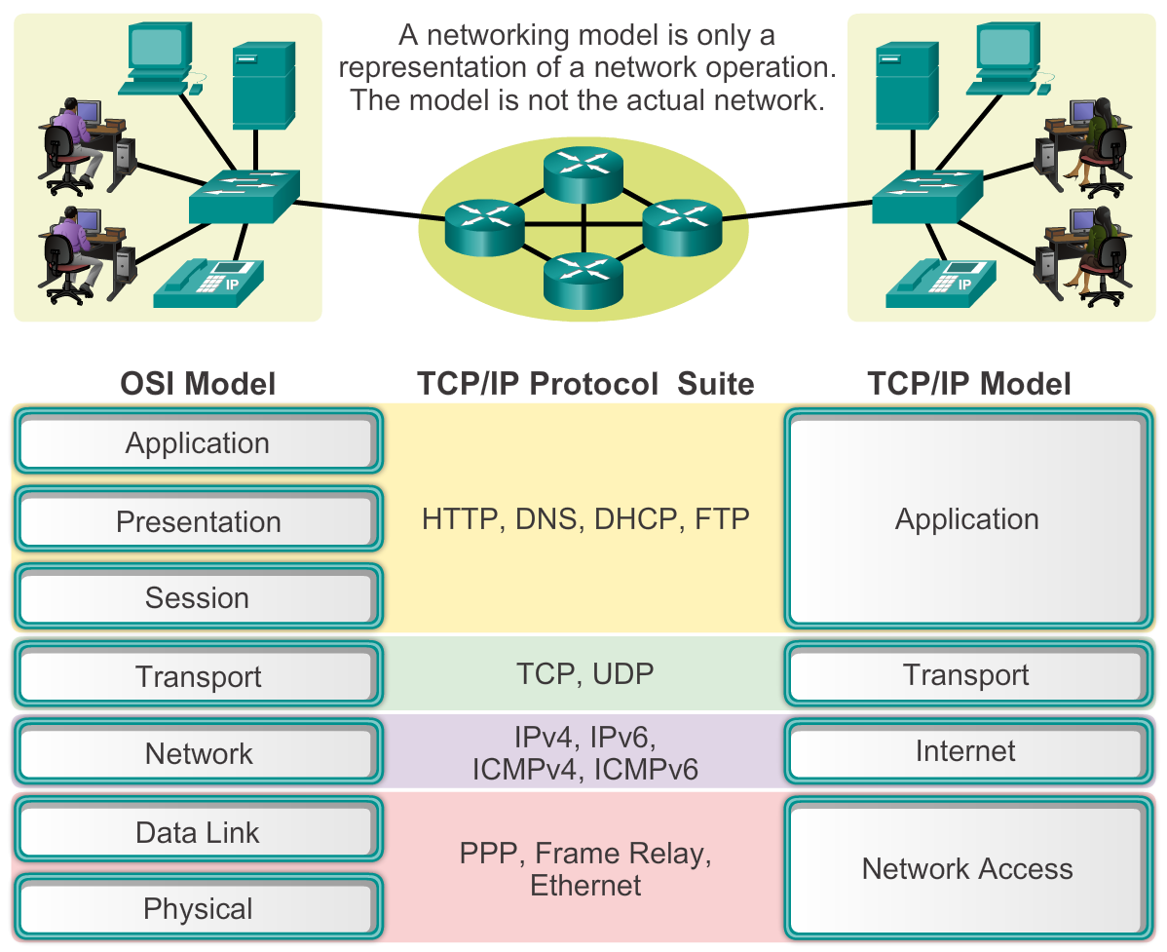
Reference Models
The Benefits of Using a Layered Model
Notes:
Section 3.1.4.1

Slide 17
Reference Models
The OSI Reference Model
Notes:
Section 3.1.4.2

Slide 18
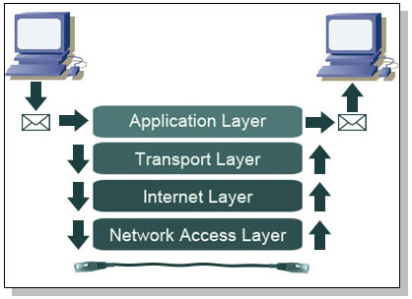
Reference Models
The TCP/IP Reference Model
Notes:
Section 3.1.4.3

Slide 19
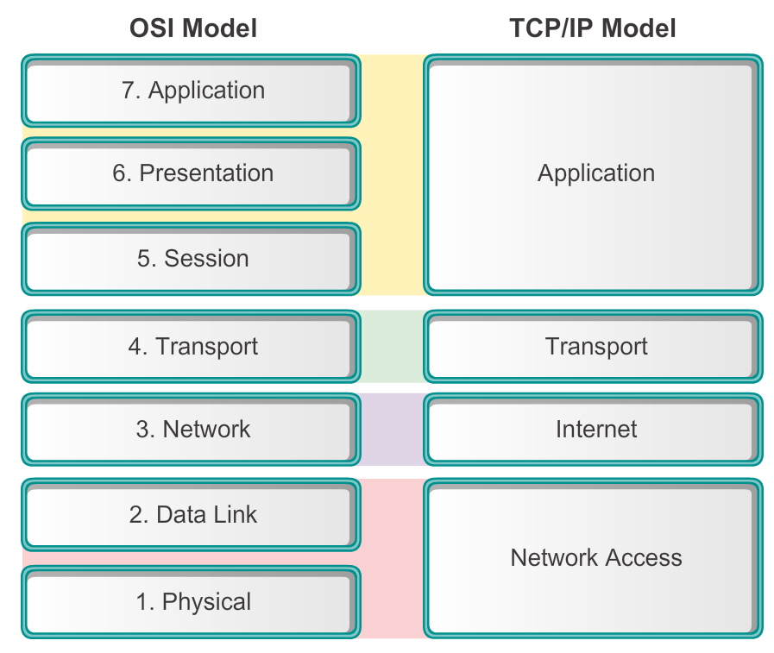
Reference Models
Comparing the OSI and TCP/IP Models
Notes:
Section 3.1.4.4

Slide 20
Using Requests for Comments
Why RFCs
Used for peer review
Not all RFCs come from IETF
Some RFCs come from IAB, IRTF, or independent submissions
Notes:
Section 3.2.1

Slide 21
Why RFCs
Request for Comments (RFC)
HTTP – RFC 2616
DHCP – RFC 2131
IPv4 – RFC 791
IPv6 – RFC 2460
RFC 1149 – delivery of IPv4 packets by carrier pigeons
RFC 6214 – extension of RFC 1149 using IPv6
Notes:
Section 3.2.1.1

Slide 22
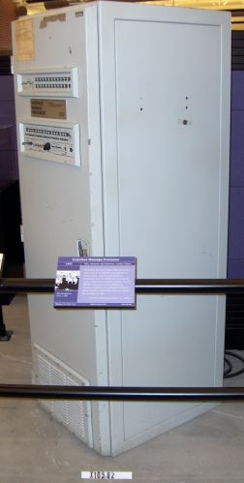
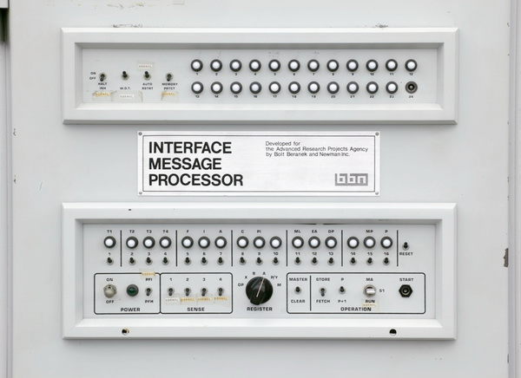
Why RFCs
History of RFCs
October 29, 1969 ARPANET sent first message (Designed by RFP)
Notes:
Section 3.2.1.2

Slide 23
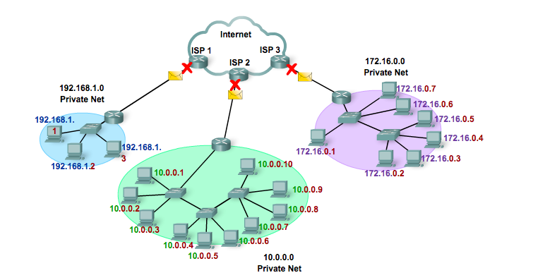
Why RFCs
Sample RFC
RFC 1918 Private Address Space
Notes:
Section 3.2.1.3

Slide 24
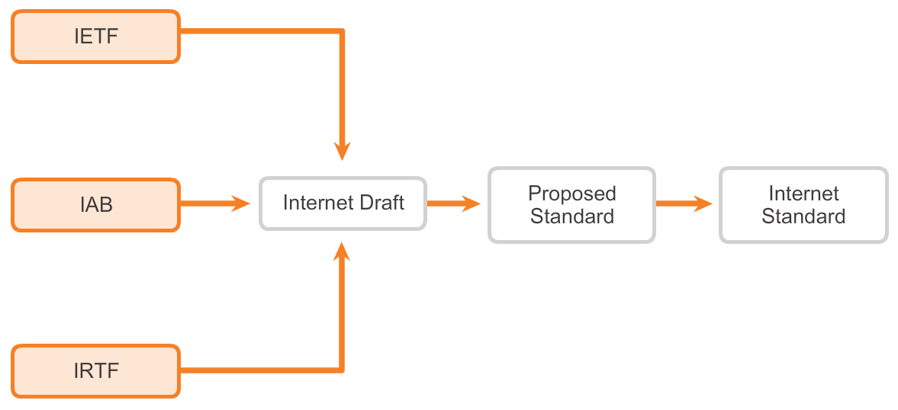
CU – Using Requests for Comments
RFC Processes
Notes:
Section 3.2.2

Slide 25
RFC Processes
RFC Process
Internet-Draft (ID)
Proposed standard
Internet standard
Notes:
Section 3.2.2.1

Slide 26
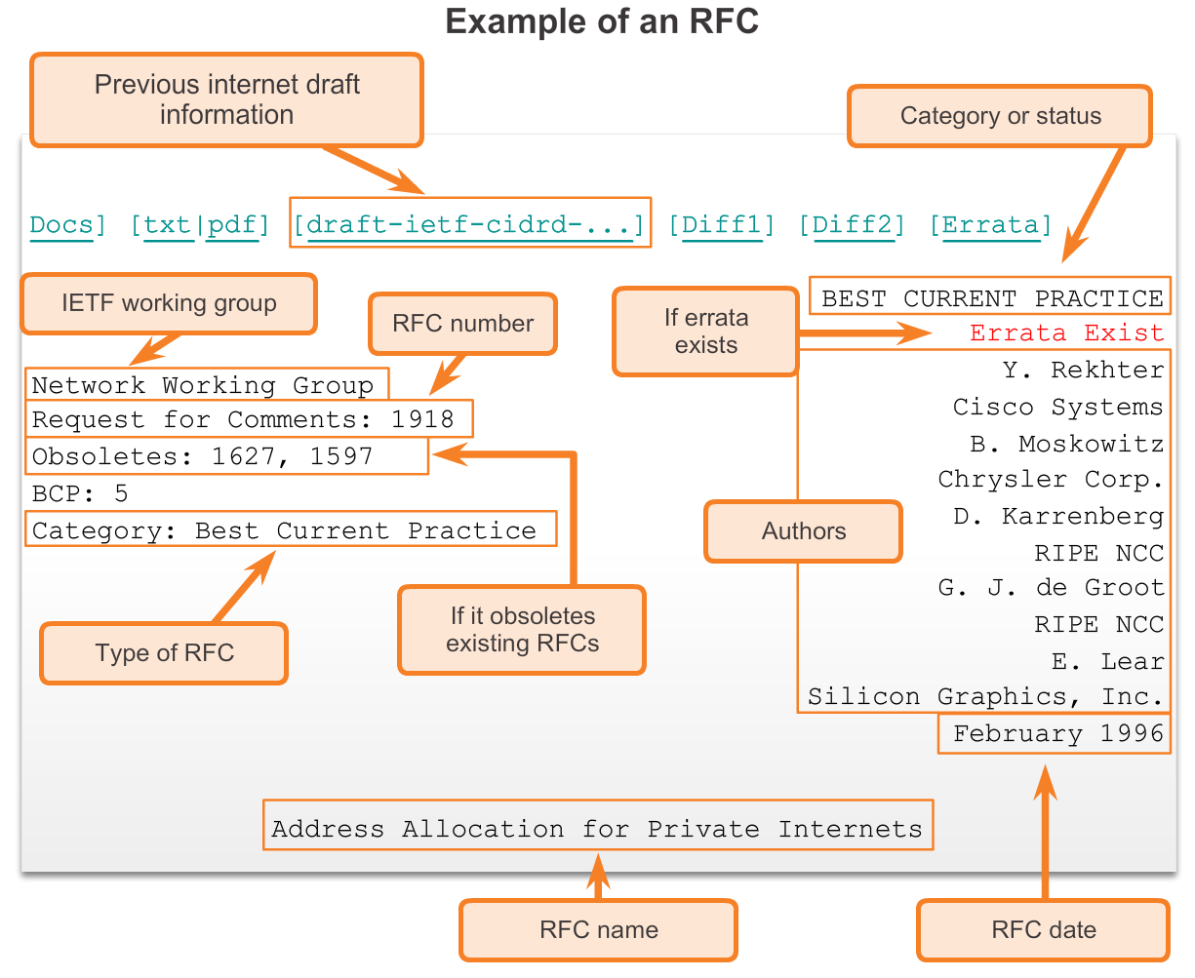
RFC Processes
RFC Types
Internet Standard
Best Current Practice (BCP)
Informational
Experimental
Historic
Notes:
Section 3.2.2.2

Slide 27
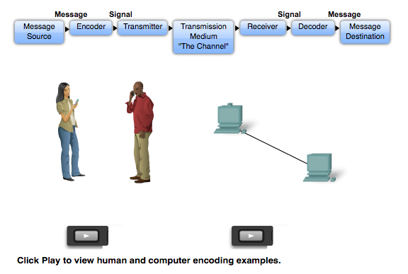
Moving Data in the Network
Data Encapsulation
Notes:
Section 1.3.1

Slide 28
Data Encapsulation
Elements of Communication
Message Source
Destination or receiver of the message
Channel
Notes:
Section 3.3.1.1

Slide 29
Data Encapsulation
Communicating the Messages
Segmenting message benefits
  Different conversations can be interleaved
  Increased reliability of network communications
Segmenting message disadvantage
  Increased level of complexity
Notes:
Section 3.3.1.2

Slide 30
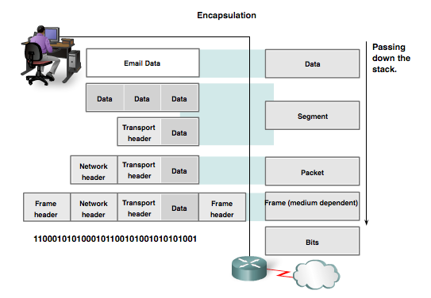
Data Encapsulation
Protocol Data Units (PDUs)
Data
Segment
Packet
Frame
Bits
Notes:
Section 3.3.1.3

Slide 31
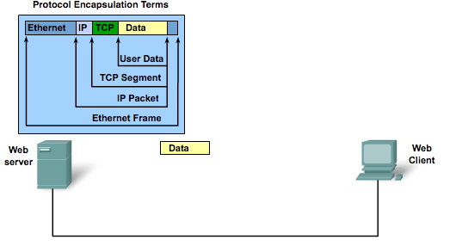
Data Encapsulation
Encapsulation
Notes:
Section 3.3.1.4

Slide 32
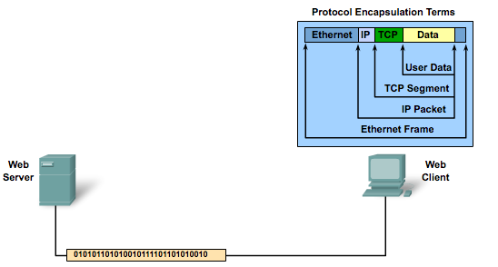
Data Encapsulation
De-encapsulation
Notes:
Section 3.3.1.5

Slide 33
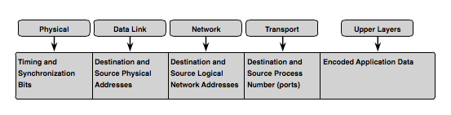
Moving Data in the Network
Accessing Local Resources
Notes:
Section 3.3.2

Slide 34
Accessing Local Resources
Network Addresses & Data Link addresses
Network Address
  Source IP address
  Destination IP address
Data Link Address
  Source data link address
  Destination data link address
Notes:
Section 3.3.2.1

Slide 35
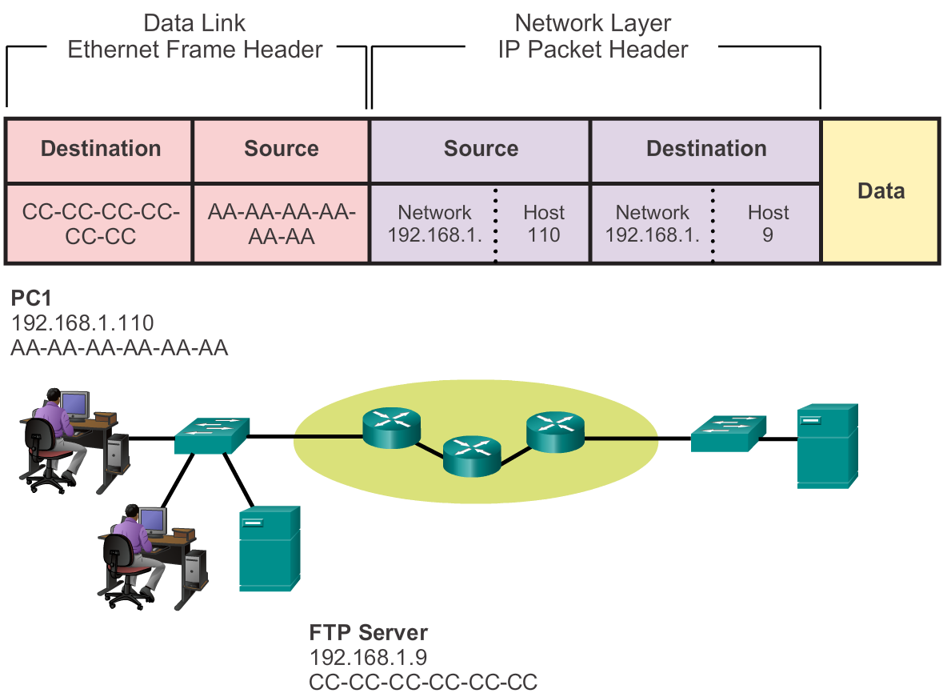

Accessing Local Resources
Communicating with Device / Same Network
Notes:
Section 3.3.2.2

Slide 36


Accessing Local Resources
MAC and IP Addresses
R1
192.168.1.1
11-11-11-11-11-11
ARP
Request
PC1
192.168.1.110
AA-AA-AA-AA-AA-AA
S1
R1
PC2
192.168.1.111
BB-BB-BB-BB-BB-BB
FTP Server
192.168.1.9
CC-CC-CC-CC-CC-CC
Notes:
Section 3.3.2.3

Slide 37
Accessing Remote Resources
Default Gateway
PC 1
192.168.1.110
AA-AA-AA-AA-AA-AA
R2
172.16.1.99
22-22-22-22-22-22
R1
192.168.1.1
11-11-11-11-11-11
Web Server
172.16.1.99
AB-CD-EF-12-34-56
PC 2
192.168.1.111
BB-BB-BB-BB-BB-BB
FTP Server
192.168.1.9
CC-CC-CC-CC-CC-CC
Notes:
Section 3.3.3.1

Slide 38
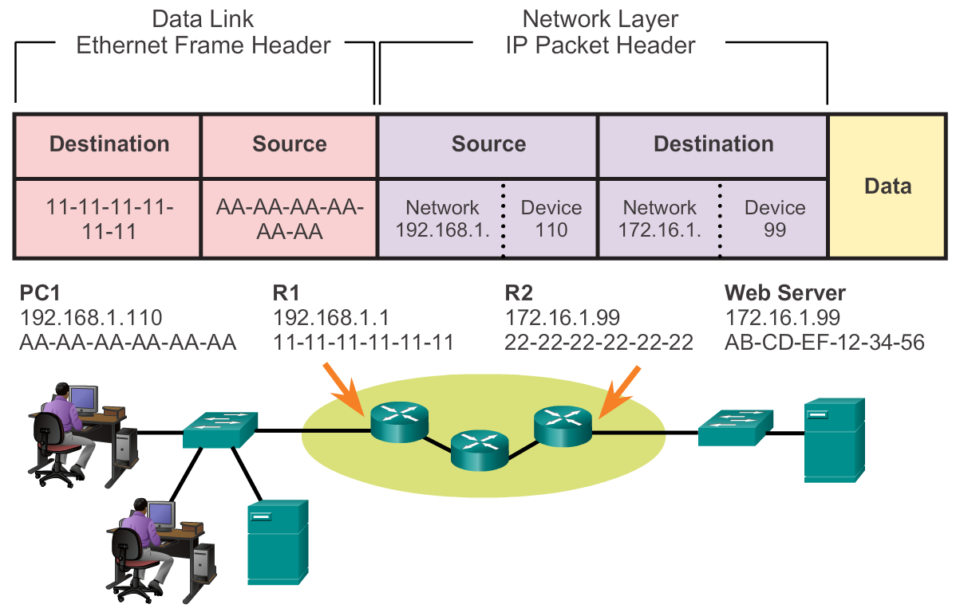
Accessing Remote Resources
Communicating Device / Remote Network
Notes:
Section 3.3.3.2

Slide 39
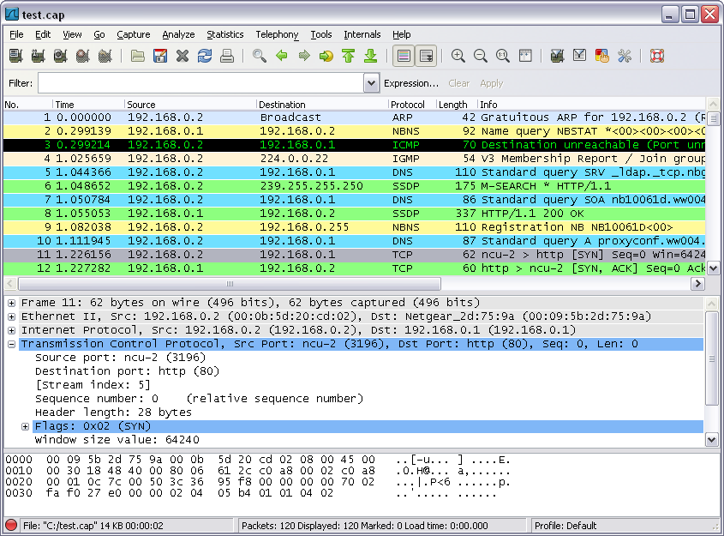
Accessing Remote Resources
Using Wireshark to View Network Traffic
Notes:
Section 3.3.3.4

Slide 40
Network Protocols and Communications
Summary
In this chapter, you learned:
Data networks are systems of end devices, intermediary devices, and the media connecting the devices. For communication to occur, these devices must know how to communicate.
These devices must comply with communication rules and protocols. TCP/IP is an example of a protocol suite.
Most protocols are created by a standards organization such as the IETF or IEEE.
The most widely-used networking models are the OSI and TCP/IP models.
Notes:
Section 1.5 & 1.5.1

Slide 41
Network Protocols and Communications
Summary
In this chapter, you learned:
Data that passes down the stack of the OSI model is segmented into pieces and encapsulated with addresses and other labels. The process is reversed as the pieces are de-encapsulated and passed up the destination protocol stack.
The OSI model describes the processes of encoding, formatting, segmenting, and encapsulating data for transmission over the network.
The TCP/IP protocol suite is an open standard protocol that has been endorsed by the networking industry and ratified, or approved, by a standards organization.
Notes:
Section 1.5 & 1.5.1

Slide 42
Network Protocols and Communications
Summary
In this chapter, you learned:
The Internet Protocol Suite is a suite of protocols required for transmitting and receiving information using the Internet.
Protocol Data Units (PDUs) are named according to the protocols of the TCP/IP suite: data, segment, packet, frame, and bits.
Applying models allows individuals, companies, and trade associations to analyze current networks and plan the networks of the future.
Notes:
Section 1.5 & 1.5.1

Slide 43


