Slide 1
Why do we need a database?
Keep records of our:
Clients
Staff
To keep a record of activities and interventions;
Keep sales records;
Longitudinal tracking

Slide 2
Database vs. File System
Coordinates Both Physical and Logical Access to the Data
Data are Shared by All Programs Authorized to Have Access to It
Flexible Access to Data (i.e., Queries)
Multiple Users Accessing the Same Data at Same Time
Coordinates Only the Physical Access to the Data
Data Written by One Program May Not Be Readable by Another Program
Pre-determined Access to Data (I.E., Compiled Programs)
No Two Programs Can Concurrently Access the Same File

Slide 3
DATABASE PURPOSES
Speed and simplicity
the database users can: store data ,make changes / manipulation of data displays the return data with faster and easier than in the normal way (either manually or electronically).
2. Storage Space Efficiency
data base capable of suppressing the amount of redundancy (repetition) of data, either by applying a number of coding or by creating relationships between groups of related data

Slide 4
DATABASE PURPOSES
3. Accuracy
For data in accordance with the rules and certain restrictions by utilizing the coding or the formation of relationships among the data along with the application of rules / constraints (constraint) data type, data domain, the uniqueness of the data etc.
4. Availability
So that data can be accessed by any user in need, with the application of network technologies and to transfer / deletion of data that have not been used / expired to save storage space

Slide 5
DATABASE PURPOSES
5. Completeness
For complete data is always managed well relative to the needs of users as well as to time, by adding rows of data or make changes to the database structure, namely by adding a field in the table or add new table
6. Security
For data that is confidential or vital process that does not fall into the people / users who are not entitled, by the use of your account (username and password) and apply the distinction of each user's access rights to data that can be read or process that can be done

Slide 6
DATABASE PURPOSES
6. Sharebility
For data which is managed by the system supports multiuser environments (multiple users), with guard / avoid the emergence of new problems such as inconsistencies in the data (because data changes made by multiple users at the same time) or a deadlock condition (because there are many users waiting for each other to use the data)

Slide 7
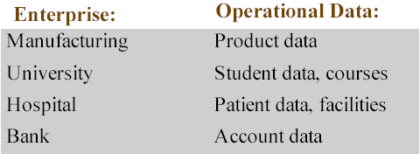
DATABASE APPLICATION
Examples
Typical Environment
Corporate Enterprise
Data With Large Homogenous Parts (e.g., Formatted Data)
Data Relevant Over a Long Time
Data Used by Many Simultaneous Users (Batch and On-line Users) for Retrieval & Update

