Slide 1
Introduction
141UK3207 – DATABASE SYSTEM
Susan Dian Purnamasari, M.Kom.
M. Ariandi, M.Kom.
Course
Provide a Practical Introduction to Database Models, Theory, and Systems
Focus on Both Theory and Practice
Theory Demonstrates of Databases (Relational Model and Concurrency Control)
Practice Provides Experimental Framework for Illustrating Theory (Actual Database Systems and their Usage)

Slide 2
Textbooks and Class Materials
Required Text
Modern Database Management 6th Edition,
Jeffrey A. Hoffer
Behaviour Model, Raymond Mc.leod Jr
Manajemen Database dengan SQL, Martinus
Joko Susanto
Konsep dan Tuntunan Praktis Basis Data, Abdul Kadir
Course Web Site and forum
Elearning.binadarma.ac.id

Slide 3
Topics & Tentative Schedule
Week | Topic | Reference
1 | Intro to course and database Database application | Ch 1 & 2
2 | Database System Component | Ch 3
3 | Data Abstraction & Database Language | Ch 4
4 | Overall System Structure | Ch 5
5 | QUIZ | Ch 1-5
6 | Relational Data Models | Ch 6

Slide 4
Topics & Tentative Schedule
Week | Topic | Reference
7 | Entity Relationship Modeling | Ch 7
8 | Entity Relationship Diagram | Ch 8
9 | Degrees of relationship | Ch 9
10 | MID Test | 1- 9
11 | Normalization Concept | Ch 10
12 | Functional Dependencies | Ch 11
13 | Data Models | Ch 12
14 | Introduction to SQL | Ch 13
15 | More SQL | Ch 14
16 | Final Test | Ch 1-14

Slide 5
Grading (tentative)
Group Project 15%
Quiz & Homeworks 15%
Mid Test 30%
Final Test 40%

Slide 6
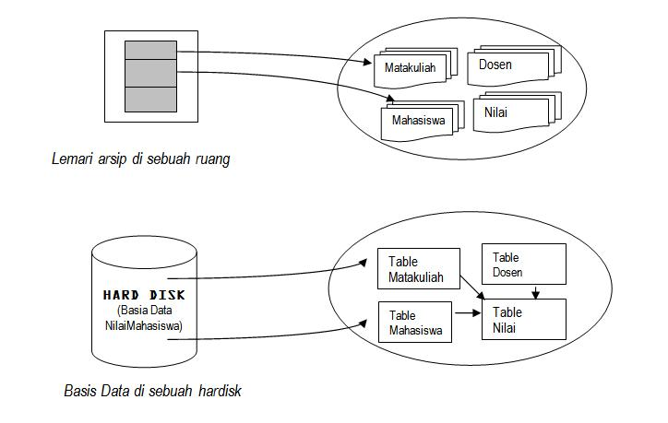
Basis Data

Slide 7
Database
File / Table Dosen
File Mata Kuliah
File/Table
Student
File Nilai

Slide 8
Field/Table
ID
Name
Sex
Age
Record
Character
001
Andi
L
19
Record
002
Ina
P
18
Item Data
003
Udin
L
20
Record

Slide 9
