Slide 1
Kamera & Studio

Slide 2
Camera DSLR

Slide 3
Aperture Range

Slide 4
Lampu Studio

Slide 5
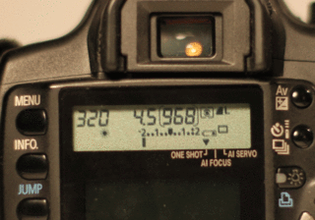
Lightmeter

Slide 6
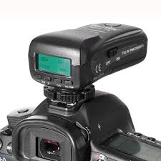
Triger

Slide 7
Flash

Slide 8
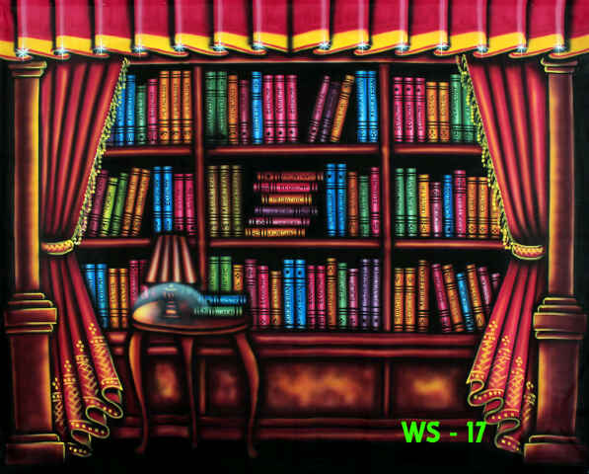
Background

Slide 9
Moving Electric Background

Slide 10
Background Stand

Slide 11
Standart Reflektor

Slide 12
Umbrella Reflector

Slide 13
Beauty Dish

Slide 14
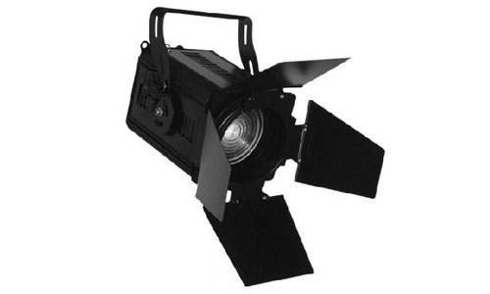
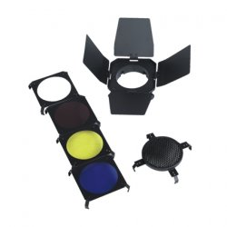
Bandoor

Slide 15
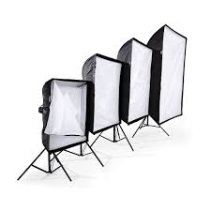
Softbox

Slide 16
Octabox

Slide 17
Umbrella Oktagon

Slide 18
Floor Light Box

Slide 19
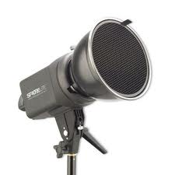
HoneyComb

Slide 20
Snoot

Slide 21
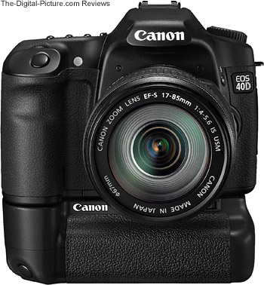
Batrey Grip

