Slide 1
NETWORK PLANNING

Slide 2
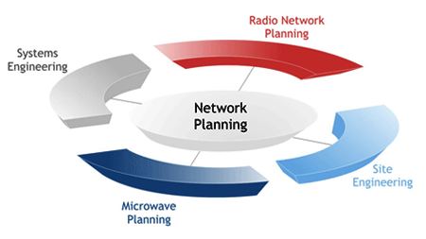

Slide 4
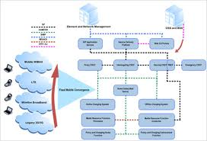

Slide 6
TERIMA KASIH

